Slide 1
Content-Based Image Retrieval at the End of the Early Years
ARNOLD SMEULDERS
MARCEL WORRING
SIMONE SANTINI
AMARNATH GUPTA
RAMESH JAIN
PRESENTERS
FATIH CAKIR
MELIHCAN TURK

Slide 2
Outline
Introduction
Scope
Description of Content
  Image Processing
  Features
Interaction
System Overview
Conclusion

Slide 3
Introduction
The paper presents a broad review about content-based image retrieval steps
  Image processing, user interaction, system architecture…
A need for visual information management systems for scientific , industrial etc applications.
  Google Image, IBM’s QBIC …

Slide 4
Scope
The user aims in content-based image retrieval systems
  Search by association
    Users have no specific aim other than finding interesting things
    There is broad class of methods and systems aimed at browsing through a large set of images from unspecified sources
  Searching at a specific image
    Searching for a precise copy of query image (e.g. art catalogues)
  Category search
    Retrieving an arbitrary image representative of a specific class.

Slide 5
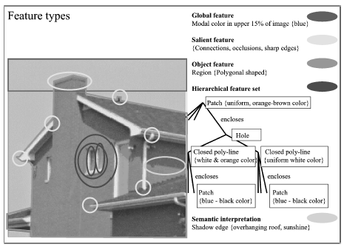
Description of Content
Analyzing the content of images
Low-level image processing techniques such as color, local shape and texture processing.
For extracting representative feature vectors of images

Slide 6
Similarity measures
Retrieving is based on similarity between feature vectors (query and image collection)
Several similarity measures exists
  Euclidean distance
  Jaccard coefficient
  Dice coefficient
  Cosine similarity
Each similarity measure is effective on different data domains

Slide 7
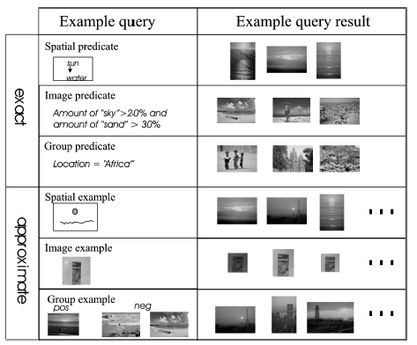
Interaction
User interface of content-based image retrieval systems

Slide 8


System
Must utilize advance storage and indexing methods for efficient and effective retrieval performance
Evaluation methods
Precision
Recall

Slide 9
Conclusion
Content-Based Image Retrieval systems has gained severe interest among research scientists since multimedia files such as images and videos has dramatically entered our lives throughout the last decade
Textual analysis is not sufficient for effective retrieval systems
Comprehensive analysis (image processing etc) is needed for higher precision
Notes:
For example, Facebook¹, a social network site, reports that more than 30 million photos are being uploaded to their servers –per day. Youtube² also reports that approximately 65 thousand videos are uploaded daily to their servers

